Slide 1
Information Warfare
Cyber-Terrorism
Cyber-Criminals
Marc Rogers

Slide 2
Outline
Concepts
Cyber-terrorism
Information Warfare
Hackers/Cyber-criminals
Canadian Laws
Cyber-criminal Case Studies

Slide 3
What is the Internet?
A network of networks, or "internet," is a group of two or more networks that are:
interconnected physically
capable of communicating and sharing data with each other
able to act together as a single network

Slide 4

What is the Internet?
The Internet covers the globe and includes large, international networks as well as many smaller, local-area networks (LANs).

Slide 5
What is the history of the Internet?
ARPANET (Advanced Research Projects Agency Network)
NSFNET (National Science Foundation Network)
Desktop computers
Network upgrades
Internet tools

Slide 6
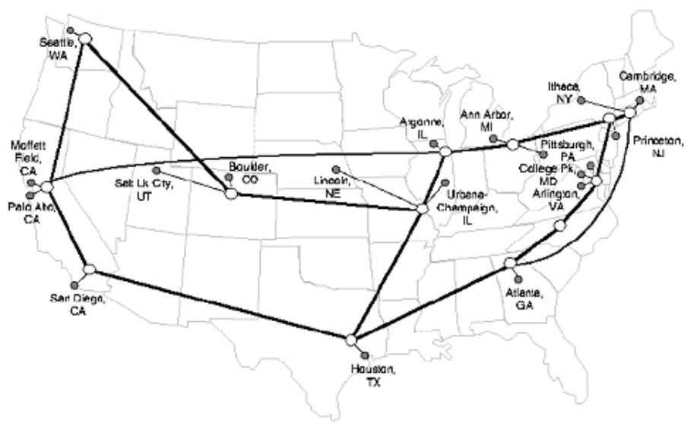
What is the history of the Internet?
To expand access to the Internet, the NSF supported the development of regional networks, which were then connected to the NSFNET backbone. In addition, the NSF supported institutions, such as universities, in their efforts to connect to the regional networks.
Here is a diagram of the NSFNET backbone, as it appeared in 1993.

Slide 7
What is the history of the Internet?
In Summary:
The Internet has evolved through a series of advancements in networking and computer technologies. From its beginning in 1969, the ARPANET provided a test-bed for networking research and development. An important development that grew out of ARPANET was the TCP/IP protocols, which provided standard rules for networked computers to communicate with each other.
Other significant events included the introduction of the desktop computer, the development of networking tools such as telnet, FTP, gopher and WWW, and the release of graphical browsers. Advancements in networking enabled the NSFNET to upgrade its speed several times, allowing more and more connections.

Slide 8
Cyber-Space
William Gibson
  Science fiction writer
  Neuromancer
The theoretical “space” that lies between the physical connection points of computer systems or networks.

Slide 9
Cyber-Terrorism
Terrorism:
FBI Definition:
  “..the unlawful use of force or violence against persons or property to intimidate or coerce a government, the civilian population, or any segment thereof, in furtherance of political or social objectives”.

Slide 10
Cyber-Terrorism
Terrorist:
  “..one who causes intense fear; one who controls, dominates, or coerces through the use of terror in furtherance of political or social objectives”.
Cyber-Terrorist:
  An individual that uses computer\network technology (i.e., networks, computers, Internet) to cause intense fear; one who uses computer\network technology to control, dominate, or coerce through the use of terror in futherance of political or social objectives.

Slide 11
Cyber-Terrorism
National Information Infrastructure (NII)
  Weak overall security
  Documented attacks on 911, air traffic control, stock exchanges, military sites, banks
Global Information Infrastructure (GII)
  Weak overall security
  No borders
  Few if any international agreements

Slide 12
Information Warfare
Definition:
  “..actions taken to achieve information superiority in support of national military strategy by affecting adversary information and information systems”
    Source: U.S Defense Information Systems Agency DISA

Slide 13
Information Warfare
Three General Categories:
Offensive
  To deny, corrupt, destroy, or exploit adversary’s information
Defensive
  To safeguard ourselves and allies from similar actions
Exploitation
  To exploit information in a timely fashion, to enhance our decision/action cycle and disrupt the adversary’s cycle

Slide 14
Information Warfare
Operation Desert Storm
  Knocked out communications systems
  Attempted to disrupt economy prior to the operation
UN in Bosnia
  Knocked out communications
  Disrupt the economy
  Propaganda and Misinformation

Slide 15
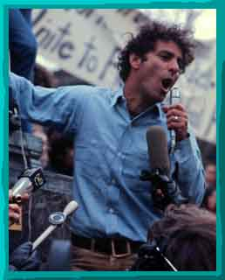
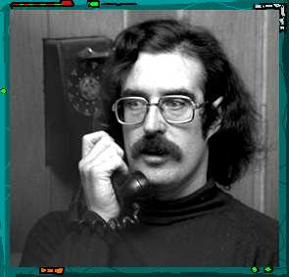
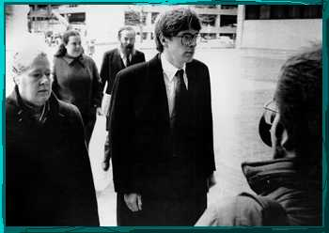
Hackers & Cyber-criminals
Robert Morris
Abbie Hoffman
John Draper “Captain Crunch”

Slide 16
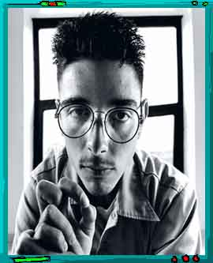
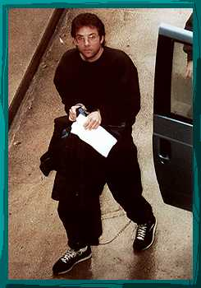
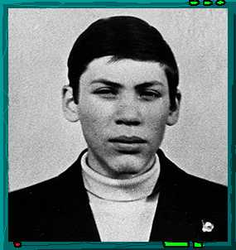
Hackers & Cyber-criminals
Mark Abene “Phiber Optik”
Kevin Mitnick
Vladimir Levin

Slide 17
Hackers
Definitions:
  1) “an expert at programming and solving problems with a computer”.
  2) “a person who illegally gains access to and sometimes tampers with information in a computer system”.
  Source: Merriam-Webster’s Collegiate Dictionary

Slide 18
Hackers:
Evolution of the Term
4 Generations of the term Hacker
  Steven Levy (3 Generations)
  1st Generation: Creative Programmer: MIT/Stanford (1960’s)
  2nd Generation: Computer Evolutionaries (1970’s)
  3rd Generation: Games & Copyright breaking (1980’s)
  *4th Generation: Criminals & Cyberpunks (1990’s)

Slide 19
Hackers:1st Generation
Creative Programmers & Scientists
Novel methods for programming (code bumming)
Hacker Ethic (The. Right. Thing.)
Very respected (Gurus)
MIT (TMRC) & Stanford (SAIL)

Slide 20
Hackers: 2nd Generation
Computer Evolutionary
Hardware Hackers
  Mainframe to personal systems
  Computer Kits (Altair, Apple)
Founders of Major Computer Companies
  Minor criminal activity: Phreaking/Blue Boxing
  Software Piracy
  Now multi-millionaires

Slide 21
Hackers: 3rd Generation
Computer Games & Copyrights
  Game Hackers
  Personal PC
  Computer for entertainment
  Methods for protecting and breaking copyright codes on games
  Minor criminal activity

Slide 22
Hackers: 4th Generation
Criminals
Cyber-punks
  Rarely technically elite
  Motivated primarily by greed, power, revenge, malicious intent
Not respected

Slide 23
Cyber-Crime
Cyber-Crime:
  “..a crime committed where the use or knowledge of computers is required”.
  (e.g., denial of service, attacking passwords)
Computer-assisted Crime:
  “a crime in which the computer is used to assist in perpetrating the crime”.
  (e.g., fraud, child pornography)

Slide 24
Cyber-Crime
First Documented Computer Crime:
  (1805) Textile Industry
  Joseph Jacquard, automated steps in weaving
  Forerunner of the punch card
  Employees upset about possibility of being replaced
  Sabotaged the system

Slide 25
Cyber-Criminals
Male
Caucasian
12-30 years old
Limited Social Skills: loners
Perform poorly in school: aptitude for computers & technology
Dysfunctional families

Slide 26
Cyber-Criminals
Socially Inept
Obsessive
Loners yet appear to crave membership:
  Chat channels
  Newsgroups
  Magazine 2600
  Conventions

Slide 27
Cyber-Criminals
Inferiority Complex:
  Nicknames: Dart Dante, Condor, Analyzer
Escapism:
  Anonymity on the Internet
  Can take on different personas
  Fantasy role playing
Rarely psycho-sociopath

Slide 28
Criminal Insiders
Technology Specialists
Introverted
Poor social skills
Over-exaggerated sense of self worth
Lack of empathy
Loose ethical boundaries

Slide 29
Criminal Insiders
Prone to emotional distress
Disappointment
Disgruntlement
Consequent failures of judgment
Sense of entitlement
Anger at authority
Revenge syndrome

Slide 30
Criminal Insiders
Critical Path Model*
Predisposing Traits
Emotional
Fallout
No
Intervention
Acute Situational
Stressor
Judgement
Failures
IT
Attack
*Shaw et al., 1998

Slide 31
Cyber-Crime
Computer Crime Laws in Canada
Electronic Data at one time not defined in Criminal Code.
No definition, cannot commit crime a against it
Computer Evidence is “hearsay”
Legislation by metaphor

Slide 32
Canadian Laws
Pre Bill C-17
Unauthorized Use of a Computer 342.1
Mischief to Data 430(1.1)
Theft of telecommunication service 326(1)
Possession of device to obtain telecommunication facility or service 327(1)

Slide 33
Canadian Laws
Unauthorized Use of a Computer 342.1
  Every one who, fraudulently and without colour of right,
  (a) obtains, directly or indirectly, any computer service,
  (b) by means of an electro-magnetic, acoustic, mechanical or other device, intercepts or causes to be intercepted, directly or indirectly, any function of a computer system, or
  (c) uses or causes to be used, directly or indirectly, a computer system with intent to commit an offence under paragraph (a) or (b) or an offence under section 430 in relation to data or a computer system
is guilty of an indictable offence and liable to imprisonment for a term not exceeding ten years, or is guilty of an offence punishable on summary conviction

Slide 34
Canadian Laws
Unauthorized Use of a Computer 342.1
  Definitions:
  342.1(2) "computer program" means data representing instructions or statements that, when executed in a computer system, causes the computer system to perform a function;
  342.1(2) "computer service" includes data processing and the storage or retrieval of data;

Slide 35
Canadian Laws
Definitions:
342.1(2) "computer system" means a device that, or a group of interconnected or related devices one or more of which,
  (a) contains computer programs or other data, and
  (b) pursuant to computer programs,
    (i) performs logic and control, and
    (ii) may perform any other function;
342.1(2) "data" means representations of information or of concepts that are being prepared or have been prepared in a form suitable for use in a computer system;

Slide 36
Canadian Laws
Definitions:
  342.1(2) "electro-magnetic, acoustic, mechanical or other device" means any device or apparatus that is used or is capable of being used to intercept any function of a computer system, but does not include a hearing aid used to correct subnormal hearing of the user to not better than normal hearing;
  342.1(2) "function" includes logic, control, arithmetic, deletion, storage and retrieval and communication or telecommunication to, from or within a computer system;
  342.1(2) "intercept" includes listen to or record a function of a computer system, or acquire the substance, meaning or purport thereof.

Slide 37
Canadian Laws
Mischief to Data 430 (1.1)
Every one commits mischief who willfully
destroys or alters data;
  (a) renders data meaningless, useless or ineffective;
  (b) obstructs, interrupts or interferes with the lawful use of data;or
  (c) obstructs, interrupts or interferes with any person in the lawful use of data or denies access to data to any person who is entitled to access thereto.

Slide 38
Canadian Laws
Mischief to Data 430 (1.1)
  The punishment in relation to data is as follows:
(5) Every one who commits mischief in relation to data
  (a) is guilty of an indictable offence and liable to imprisonment for a term not exceeding ten years; or
  (b) is guilty of an offence punishable on summary conviction.

Slide 39
Canadian Laws
Theft of telecommunication service 326.1
Every one commits theft who fraudulently, maliciously, or without colour of right,
  (a) abstracts, consumes or uses electricity or gas or causes it to be wasted or diverted; or
  (b) uses any telecommunication facility or obtains any telecommunication service.

Slide 40
Canadian Laws
Definition of telecommunication are contained in the section:
  (2) In this section and section 327, "telecommunication" means any transmission, emission or reception of signs, signals, writing, images or sounds or intelligence of any nature by wire, radio, visual or other electromagnetic system.

Slide 41
Canadian Laws
Possession of device to obtain
telecommunication facility or service
327(1)
Every one who, without lawful excuse, the proof of which lies on him, manufactures, possesses, sells or offers for sale or distributes any instrument or device or any component thereof, the design of which renders it primarily useful for obtaining the use of any telecommunication facility or service, under circumstances that give rise to a reasonable inference that the device has been used or is or was intended to be used to obtain the use of any telecommunication facility or service without payment of a lawful charge therefor, is guilty of an indictable offence and liable to imprisonment for a term not exceeding two years

Slide 42
Canadian Laws
Bill C-17
Introduced more computer specific offences
Unauthorized use of a computer system amendment 342.1(1)(d) states:
    everyone who uses, possesses, traffics in or permits another person to have access to a computer password that would enable a person to commit an offence under paragraph (a), (b) or ( c).
    Commits an offence.

Slide 43
Canadian Laws
Bill C-17
The amended section defines a computer password as:
    any data by which a computer service or computer system is capable of being obtained or used.
Traffic is defined as:
    in respect of a computer password, to sell, export from or import into Canada, distribute or deal with in any other way.

Slide 44
Canadian Laws
Theft forgery, etc., of credit card 342.(1)
Section 342 also contains an amendment that makes possessing unauthorized credit data and trafficking in credit card passwords an offence. The amendment states:
342(3) Every person who, fraudulently and without colour of right, possess, uses, traffics in or permits another person to use credit card data, whether or not authentic, that would enable a person to use a credit card or to obtain the services that are provided by the issuer of a credit card to credit card holder is guilty of...

Slide 45
Canadian Laws
Theft forgery, etc., of credit card 342.(1)
  (a) an indictable offence and is liable to imprisonment for a term not exceeding ten years; or
  (b) an offence punishable on summary conviction
  (4) In this section ‘traffic” means, in relation to a credit card or credit data, to sell, export from or import into Canada, distribute or deal in any other way.

Slide 46
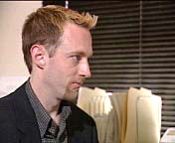
Case Study “Dark Dante”
1989, first US hacker charged with espionage
Kevin Poulsen
  Phreaker
  PacBell
  Juvenile incidents
Employed Stanford Research Institute (SRI)
  Secret & Top Secret projects for US Govt.

Slide 47
Case Study “Dark Dante”
Break & Enter to PacBell Central Offices (CO)
Arrested for attacking PacBell and found to be in possession of documents classified as “secret”
Fled while on bail awaiting indictment
Fugitive for 2yrs
  tapped phone lines of FBI, judges, & prosecutors

Slide 48
Case Study “Dark Dante”
Ran escort services, defrauded radio game shows for cars,trips, and money
Featured on “Unsolved Mysteries”
  Attacked their phone lines during the episode
Arrested by FBI and charged with Espionage for possessing a magnetic tape classified as “Secret”
Espionage charge dropped, convicted on privacy and computer fraud charges

Slide 49
Case Study “Dark Dante”
Sentenced to 51 months in jail and ordered to pay $70,000.00 in fines
Released from jail in 1996
Columnist for ZDNET News

Slide 50
Case Study “Condor”
1989, Most infamous Hacker
to date
Kevin Mitnick:
  Phreaker, PacBell
Arrested early in career and spent time in a white collar prison
Upon release returned to hacking violating release conditions

Slide 51
Case Study “Condor”
Attacked multiple networks
  Military
  Commercial
  Private
  Research
Tsutomu Shimomura
  former hacker
  research scientist San Diego Super Computer Center

Slide 52
Case Study “Condor”
Mitnick stole advanced hacking software from Shimomura’s system
Shimomura embarrassed joins hunt
Mitnick attacking AT&T cellular systems
Tracked down due to carelessness
Media “darling”
Arrested in 1995
Possession of over 20,000 credit card numbers

Slide 53
Case Study “Condor”
Served 22 months for probation violation
Recent charges have still not made it to trial
  25 counts of computer and wire fraud
Numerous books written on Mitnick
Released Jan 2000

Slide 54
Case Study “Citi-Bank”
1995, First documented attack
on US Bank
Vladimir Levin:
  System Administrator for
  AO Saturn St. Petersburg, Russia
Citi-Corp/ Citi-Bank
Jevgenij Korolkov
  Russia Businessman in San Francisco

Slide 55
Case Study “Citi-Bank”
Attacked Citi-Bank system and obtained userids and passwords
Setup accounts in Banks throughout the world
  Bank of America, Banco del Sud Argentina, Bank Artha Graha Indonesia
Transferred $12 million to the various accounts

Slide 56
Case Study “Citi-Bank”
FBI & Interpol
Arrested and in Feb 1997 sentenced to 3 years in prison and ordered to pay $240,000.00 to Citi-Bank
Citi-Bank had been warned about lax security, but ignored the warnings
Citi-Bank now extremely security conscious

